Slide 1
Chapter 2: Tools and storing to Analyze Big Data
Course Title: Big Data Analysis

Slide 2

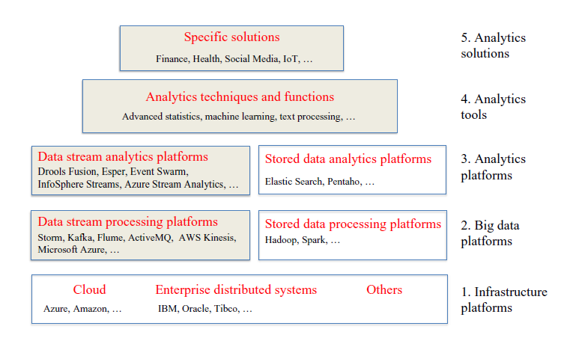

Slide 3


Distributed processing is non-trivial
How to assign tasks to different workers in an efficient way?
What happens if tasks fail?
How do workers exchange results?
How to synchronize distributed tasks allocated to different workers?

Slide 4

Big data storage is challenging
Data Volumes are massive
Reliability of Storing data is challenging
All kinds of failures: Disk/Hardware/Network Failures
Probability of failures simply increase with the number of machines
Complexity of data is increased

Slide 5
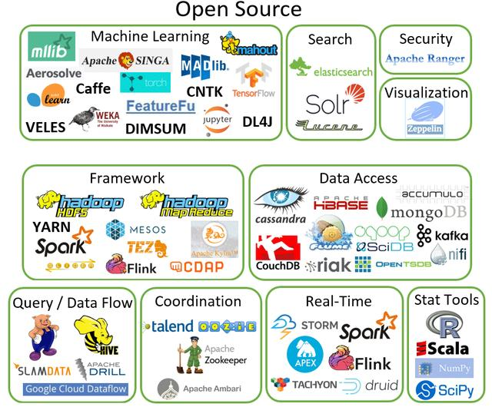
Big Data Open Source Tools

Slide 6

Tools and its applications
Big data tools inlcudes
  Apache Hadoop
    MapReduce
    HDFS
    HBase
    Hive and Pig
    Mahout
    Spark

Slide 7
What is Hadoop
It is an open-source data storage and processing platform
  Before the advent of Hadoop, storage and processing of big data was a big challenge.
Massively scalable, automatically parallelizable
  Based on work from Google: similarity and differences
    Google: GFS + MapReduce + BigTable (Not open)
    Hadoop: HDFS + Hadoop MapReduce + HBase（opensource)

Slide 8


Hadoop offers
Redundant, Fault-tolerant data storage
Parallel computation framework
Job coordination
Q: Where file is located?
No longer need to worry about
Q: How to handle failures & data lost?
Q: How to divide computation?
Programmers
Q: How to program for scaling?

Slide 9
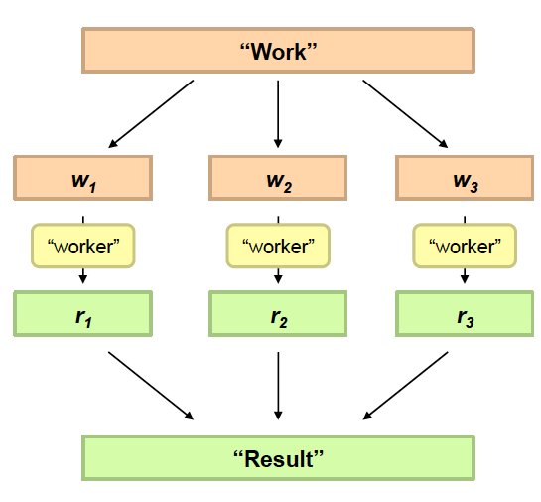
Philosophy to Scale for Big Data Processing
Divide Work
Combine Results

Slide 10
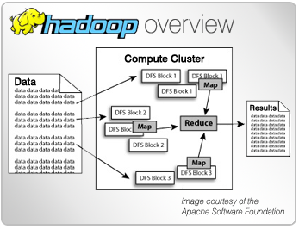
Why Use Hadoop?
Cheaper
  Scales to Petabytes or more easily
Faster
  Parallel data processing
Better
  Suited for particular types of big data problems

Slide 11
















Companies Using Hadoop

Slide 12
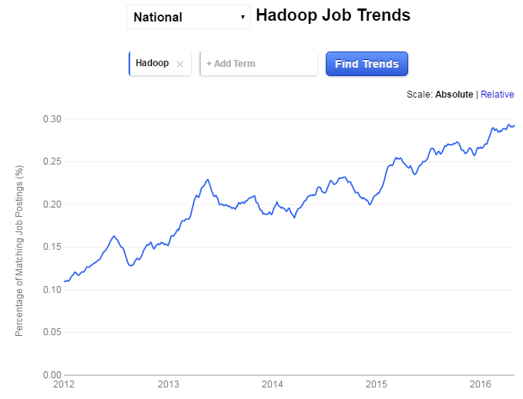
Forecast growth of Hadoop Job Market

Slide 13
Hadoop is a set of Apache Frameworks: core parts
Data storage (HDFS)
  Runs on commodity hardware (usually Linux)
  Horizontally scalable
Processing (MapReduce)
  Parallelized (scalable) processing
  Fault Tolerant
Other Tools / Frameworks
  Data Access
    HBase, Hive, Pig, Mahout
  Tools
    Hue, Sqoop
  Monitoring
    Greenplum, Cloudera
Monitoring & Alerting
Tools & Libraries
Data Access
MapReduce API
Hadoop Core - HDFS

Slide 14


What are the core parts of a Hadoop distribution?
HDFS Storage
MapReduce API
Redundant
For large files – large blocks
64 or 128 MB / block
Can scale to 1000s of nodes
Batch (Job) processing
Distributed and Localized to clusters (Map)
Auto-Parallelizable for huge amounts of data
Fault-tolerant (auto retries)
Adds high availability and more
Other Libraries
Pig
Hive
HBase
Others

Slide 15
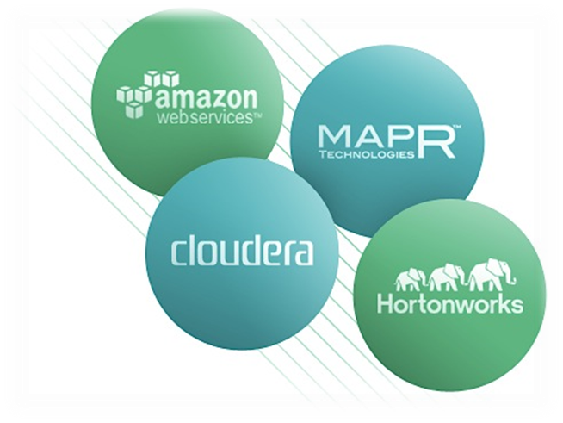
Common Hadoop Distributions
Open Source
  Apache
Commercial
  Cloudera
  Hortonworks
  MapR
  AWS MapReduce
  Microsoft Azure HDInsight (Beta)

Slide 16

Setting up Hadoop Development
Hadoop Binaries
Data Storage
MapReduce
Other Libraries & Tools
Local install
  Linux
  Windows
Local
  File System
  HDFS Pseudo-distributed (single-node)
Local
Vendor Tools
Cloudera’s Demo VM
  Need Virtualization software, i.e. VMware, etc…
Cloud
  AWS
  Azure
  Others
Cloud
Libraries
Cloud
  AWS
  Microsoft (Beta)
  Others

Slide 17


Comparing: RDBMS vs. Hadoop
 | Traditional RDBMS | Hadoop / MapReduce
Data Size | Gigabytes (Terabytes) | Petabytes (Hexabytes)
Access | Interactive and Batch | Batch – NOT Interactive
Updates | Read / Write many times | Write once, Read many times
Structure | Static Schema | Dynamic Schema
Integrity | High (ACID) | Low
Scaling | Nonlinear | Linear
Query Response Time | Can be near immediate | Has latency (due to batch processing)
Notes:
Atomicity, Consistency, Isolation, Durability

Slide 18
Storing Big Data
Big Data NoSQL(Stands for Not Only SQL) databases were founded by top internet companies like Amazon, Google, LinkedIn and Facebook to overcome the drawbacks of RDBMS.
  RDBMS is not always the best solution for all situations as it cannot meet the increasing growth of unstructured data.
  As data processing requirements grow exponentially, NoSQL is a dynamic and cloud friendly approach to dynamically process unstructured data with ease.
IT professionals often debate the merits of SQL vs. NoSQL but with increasing business data management needs, NoSQL is becoming the new darling of the big data movement.
As per the web statistics report in 2016, there are about 4 billion people who are connected to the World Wide Web.
  The amount of time that the internet users spend on the web is somewhere close to 40 billion hours per month, which is increasing.

Slide 19
  With the availability of several mobile and web applications, it is pretty common to have billions of users- who will generate a lot of unstructured data.
There is a need for a database technology that can render 24/7 support to store, process and analyze this data using NoSQL.
NoSQL:
  Class of non-relational data storage systems
  Usually do not require a fixed table schema nor do they use the concept of joins
  All NoSQL offerings relax one or more of the ACID properties

Slide 20
What kinds of NoSQL
NoSQL solutions fall into two major areas:
  Key/Value or ‘the big hash table’.
    Amazon S3 (Dynamo)
    Voldemort
    Scalaris
    Memcached (in-memory key/value store)
    Redis
  Schema-less which comes in multiple flavors, column-based, document-based or graph-based.
    Cassandra (column-based)
    CouchDB (document-based)
    MongoDB(document-based)
    Neo4J (graph-based)
    HBase (column-based)

Slide 21
Key/Value
Pros:
  very fast
  very scalable
  simple model
  able to distribute horizontally
Cons: - many data structures (objects) can't be easily modeled as key value pairs
Common Advantages
  Cheap, easy to implement (open source)
  Data are replicated to multiple nodes (therefore identical and fault-tolerant) and can be partitioned
    Down nodes easily replaced
    No single point of failure
  Easy to distribute
  Don't require a schema
    Can scale up and down
  Relax the data consistency requirement (CAP)

Slide 22
Several different varieties of NoSQL databases have been created to support specific needs and use cases. These databases can broadly be categorized into four types:
1. Key-value store NoSQL database
From an API perspective, key-value stores are the simplest NoSQL data stores to use. The client can either get the value for the key, assign a value for a key or delete a key from the data store.
Since key-value stores always use primary-key access, they generally have great performance and can be easily scaled.
The key-value database uses a hash table to store unique keys and pointers (in some databases it’s also called the inverted index) with respect to each data value it stores.
The implementation is easy. Key-value databases give great performance and can be very easily scaled as per business needs.

Slide 23
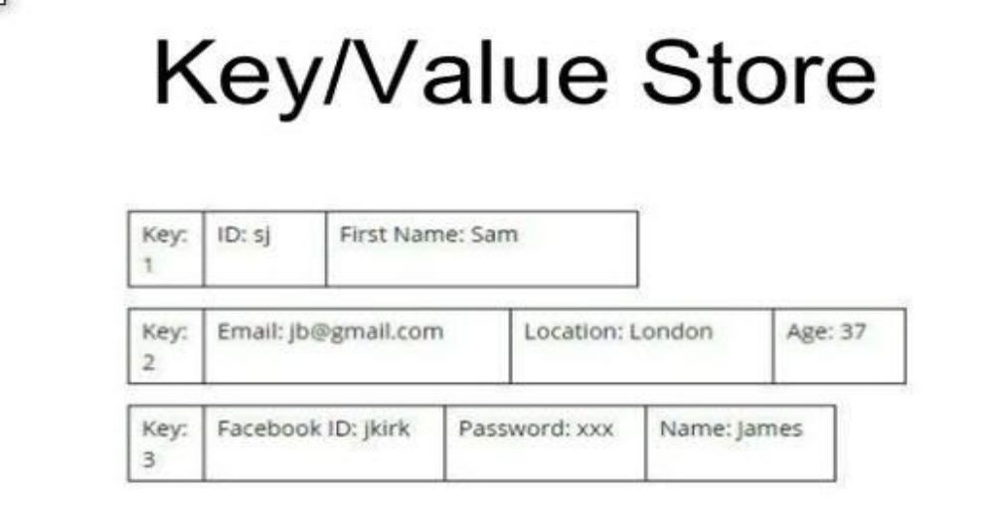
However key-value databases are not the ideal choice for every use case when:
  o We have to query the database by specific data value.
  o We need relationships between data values.
  o We need to operate on multiple unique keys.
  o Our business needs updating a part of the value frequently.
  Examples of this database are Redis, MemcacheDB and Riak.

Slide 24
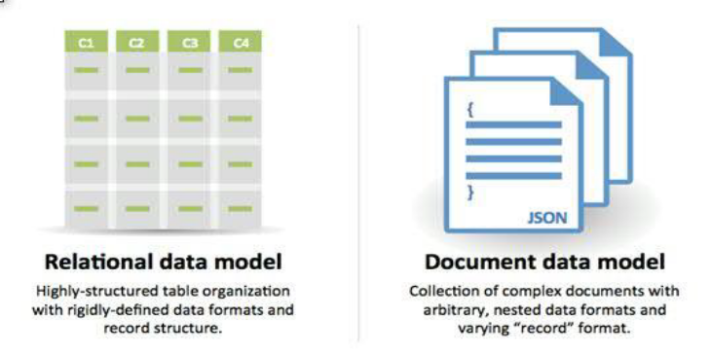
2. Document store NoSQL database
Document store NoSQL databases are similar to key-value databases in that there’s a key and a value.
  Data is stored as a value.
Its associated key is the unique identifier for that value. The difference is that, in a document database, the value contains structured or semi-structured data.
This structured/semi-structured value is referred to as a document and can be in XML, JSON or BSON format.
Use cases: Document store databases are preferable for:
  o E-commerce platforms, Content management systems.
  o Analytics platforms, o Blogging platforms.
Examples of document store NoSQL databases are MongoDB, Apache CouchDB and Elastic search.

Slide 25
3. Column store NoSQL database
In column-oriented NoSQL databases, data is stored in cells grouped in columns of data rather than as rows of data.
Columns are logically grouped into column families. Column families can contain a virtually unlimited number of columns that can be created at runtime or while defining the schema.
  Read and write is done using columns rather than rows.
Column families are groups of similar data that is usually accessed together. As an example, we often access customers’ names and profile information at the same time, but not the information on their orders.
The main advantages of storing data in columns over relational DBMS are fast search/access and data aggregation. Relational databases store a single row as a continuous disk entry.
Different rows are stored in different places on the disk while columnar databases store all the cells corresponding to a column as a continuous disk entry, thus making the search/access faster.

Slide 26
Each column family can be compared to a container of rows in an RDBMS table, where the key identifies the row and the row consists of multiple columns.
  The difference is that various rows do not have to have the same columns, and columns can be added to any row at any time without having to add them to other rows.
Use cases: Developers mainly use column databases in:
  o Content management systems
  o Blogging platforms
  o Systems that maintain counters
  o Services that have expiring usage
  o Systems that require heavy write requests (like log aggregators)

Slide 27
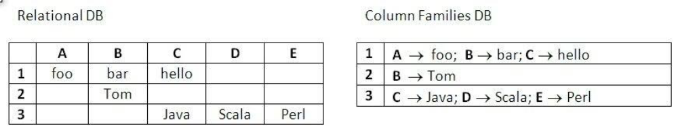
A Representation of Column store on NoSQL
N.B:
Column store databases should be avoided if you have to use complex querying or if your querying patterns frequently change. Also avoid them if you don’t have an established database requirement, a trend which we are beginning to see in new systems.
Examples of column store NoSQL databases are Cassandra and Apache Hadoop Hbase.

Slide 28
4. Graph base NoSQL database
Graph databases are basically built upon the Entity/node – Attribute – Value model.
It is a very flexible way to describe how data relates to other data. Nodes store data about each entity in the database, relationships describe a relationship between nodes, and a property is simply the node on the opposite end of the relationship.
Whereas a traditional database stores a description of each possible relationship in foreign key fields or junction tables, graph databases allow for virtually any relationship to be defined on-the-fly.

Slide 29
Use cases: Graph base NoSQL databases are usually used in:
  o Fraud detection
  o Graph based search
  o Network and IT operations
  o Social networks, etc
Examples of graph base NoSQL databases are Neo4j, ArangoDB and OrientDB.

Slide 30
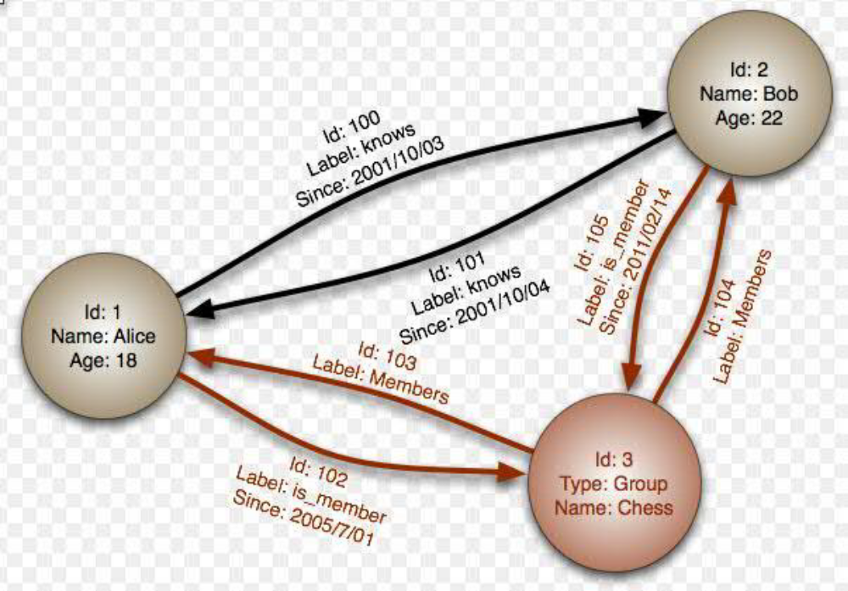
A Representation of Graph base on NoSQL

Slide 31
Review Questions
What makes Hadoop and NoSQL are more unique than the conventional tools? Show by examples.
Describe the working principle of Big data processing?
Advantages and disadvantages of big data?
What are the main category of big-data databases? Show the use cases of each by graphical example.

Slide 32
Assignment1:
Configure an Hadoop software and demonstrate/ present how it works ( 20%).
Assignment 2 (10 %) due on 18/10/2013:
  Read one article that has been done in big data using machine learning, and present in ppt.

